Slide 1
Elements of statistics
P.Julia Mary
department of mathematics

Slide 2
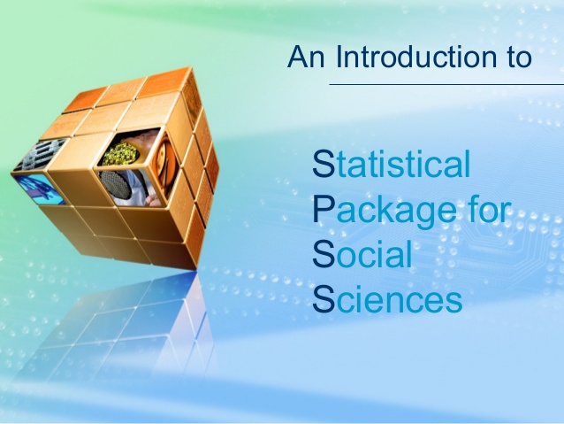

Slide 3


Slide 4
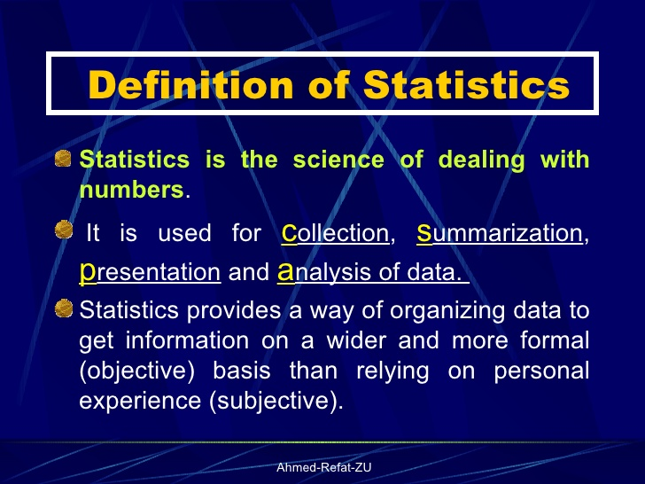

Slide 5
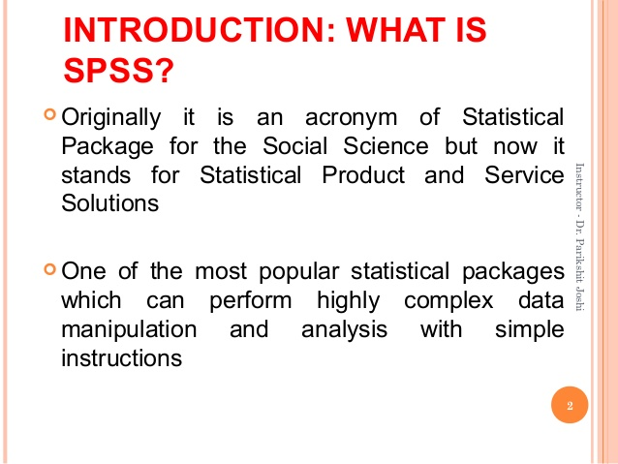

Slide 6
Introduction to SPSS
SPSS is a very powerful and user friendly program for statistical analyses.
Anyone with a basic knowledge of statistics who is familiar with Microsoft Office can easily learn how to run very complicated analyses in SPSS with a simple click of the mouse.

Slide 7
SPSS MAIN MENUS
File menu
Edit menu
View Menu
Data
Transform
Analyze
Graphs
Utilities
Add-ons
Window
Help

Slide 8
WORKING WITH THE DATA EDITOR
In SPSS 14.o, multiple data editor windows can be opened simultaneously, much like Microsoft Excel.
At the bottom of the data editor there are two tabs are they:
1. Data View
2. Variable View

Slide 9
SPSS VIEWER
Whenever we run any command in SPSS, the output is shown in the SPSS Viewer which opens as a separate window.
We can also specify the commands to be displayed in log in the Viewer window.
Edit-Options-Viewer.
The SPSS Viewer window has two panels.
1. Right panel shows actual output & log of commends
2. Left panel shows an outline of the output shown in the right hand panel.

Slide 10
IMPORTANTING AND EXPORTING DATA
SPSS gives users a variety of options to open a data file. Cilck on File-Open-Data.... As shown in a dialogue box.
We can choose the type of file we want to open in SPSS. The file type can be chosen from the drop down menu.
The data files from programs like Excel, Systat, Lotus, dBase, SAS, STATA in addition to text and ASCII formats.

Slide 11
BASIC STATISTICAL CONCEPTS
The purpose of this chapter is to introduce such readers to the common statistical terms and concepts which one must know on order to interpret computer generated outputs. This is not to under-emphasize the value of learning the nitty-gritty of statistical techniques.
However, as the objective of this book is to help students use SPSS for their research, we limit the discussion in this chapter to the practical aspects of statistical software package, capable of doing statistical analyses for us.

Slide 12
RESEARCH IN BEHAVIORAL SCIENCES
One of the main objective of a behavioral scientist is to develop theories and principles which provide insights into human and organization behavior.
1. Qualitative Research: Qualitative Research involves collecting qualitative data by way of in-depth interviews, observations, field notes,open-ended questions etc.
2. Quantitative Research: This is involves collecting quantitative data based on precise measurement using structured, reliable and validated data collection instrument or through archival data sources.

Slide 13
TYPES OF VARIABLES
A variable is a characteristic of an individual or object that can be measured.
There are two types of variables are they:
1. Qualitative Variables.
2. Quantitative Variables.

Slide 14
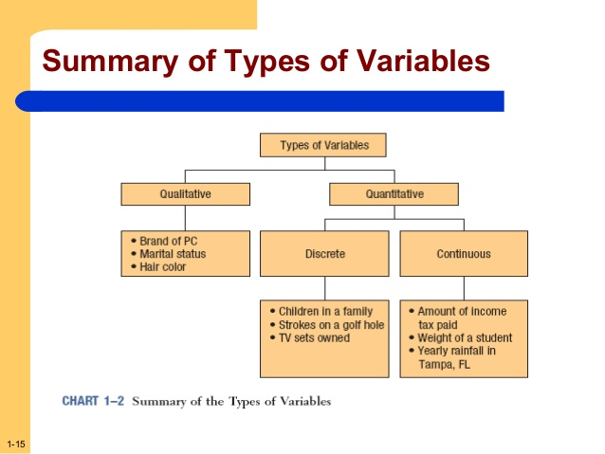

Slide 15
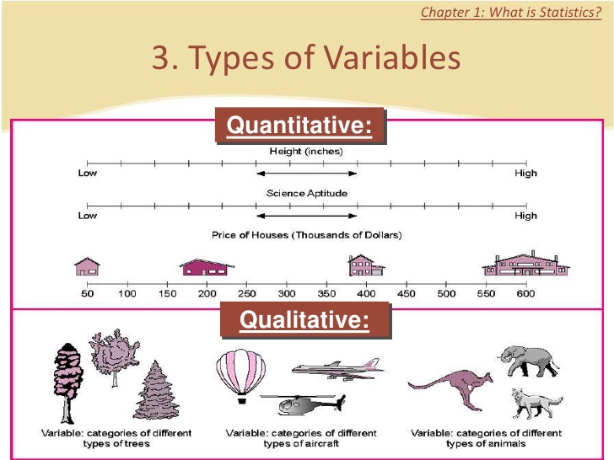

Slide 16
QUALITATIVE VARIABLES
Qualitative variables are those variables which differ in kind rather than degree. Those could be measured on nominal or ordinal scales.
(1) The nominal scale indicates categorizing into groups or classes. For example, gender, religion, race, occupation etc.
(2) The ordinal scale indicates ordering of items. For example, agreement-disagreement scale, consumer satisfaction rating etc.

Slide 17
QUANTITATIVE VARIABLES
Quantitative variables are those variables which differ in degree rather than kind. These could be measured on interval or ratio scales.
(1) The interval scale indicates rank and distance from an arbitrary zero measured in unit intervals. For example, temperature, examination scores etc.
(2) The ratio scale indicates rank and distance from a natural zero. For example, height, monthly, consumption, annual budget etc.

Slide 18
RELIABILITY AND VALIDITY
Reliability refers to the confidence we can place on the measuring instrument to give us the same numeric value when the measurement is repeated on the same object.
Validity on the other hand means that our measuring instrument actually measures the property it is supposed to measure. Reliability of an instrument does not warranty its validity.
(1) Assessing Reliability
(2) Assessing Validity

Slide 19
ASSESSING RELIABILITY
Reliability is the degree to which one may expect to find the same result if a measurement is repeated. One way to ideally measure reliability is by the test-retest method.
Once a subject has been put through some test, it will no longer remain neutral to the test.
The commonly used techniques for assessing reliability include Cohen’s kappa coefficient for categorical data and Cronbach’s alpha for internal reliability of a set of questions .

Slide 20
ASSESSING VALIDITY
The objective of assessing validity is to see how accurate is the relationship between the measure and the underlying trait it is trying to measure. The first step in assessing validity is called the face validity test.
The face validity test is done by showing the instrument to experts and actual subject and analyzing their responses qualitatively.
(1) Predictive validity
(2) Content validity
(3) Construct validity.

Slide 21
HYPOTHESIS TESTING
Hypothesis testing is a process for choosing between different alternatives. The alternatives have to be mutually exclusive and exhaustive. In the example of the electric bulb manufacturer, the following two options will have to be considered to verify the manufacturer’s claim:
(1) Average life of the bulb is greater than or equal to 1000 hours.
(2) Average life of the bulb is less than 1000 hours.

Slide 22
Typically, in hypothesis testing, we have two options to choose from.
(1) Null Hypothesis (H0)-It is the presumption that is accepted as correct unless there is strong evidence against it.
(2) Alternative Hypothesis (H1)-It is accepted when H0 is rejected.
Hypothesis testing helps in decision-making in real life business, economics and research-related problems. Some examples are:
(1) Marketing (5) Quality Control
(2) Production (6) Economics
(3) Finance (7) Research
(4) Human Resource

Slide 23
SUMMARIZING DATA: DESCRIPTIVE STATISTICS
A manager in his day-to-day operations requires as much information as possible about the business performance, economic environment and industry trends to be able to make the right decisions.
This chapter presents some of the tools for summarizing various kinds of data with the help of SPSS and MS Excel. Some basic terms and concepts have also been briefly explained but the emphasis is in explaining the use of a software package for summarizing data.

Slide 24
BASIC CONCEPTS
Descriptive statistics are numerical and graphical methods used to summarize data and bring forth the underlying information. The numerical methods include measures of central tendency and measures of variability.
(1) Measures of Central Tendency
(2) Measures of Variability
(3) Percentiles, Quartiles and Interquartile Range
(4) Skewness

Slide 25
Measures of Central Tendency
Measures of central tendency provide information about a representative value of the data set. Arithmetic mean, median, mode are the most common measures of central tendency.
1. Mean or average is the sum of the values of a variables divided by the number of observations.
2. Median is a point in the data set above and below which half of the cases fall.
3. Mode is the most frequently occurring value in a data set.

Slide 26
Measures of Variability
Measures of variability provide information about the amount of spread or dispersion among the variables.
1. Range is the difference between the largest and the smallest value.
2. Variance is the sum of the squared deviations of each value from the mean divided by the number of observations.
3. Standard deviation is the positive square root of variance.

Slide 27
PERCENTILES, QUARTILES AND INTERQUARTILE RANGE
Percentiles and quartiles are used to find the relative standing of values in a data set.
The nth percentile is a number such that n% of the values are at or below this number. Median is the 50th percentile or the 2nd quartile Similarly, the 1st quartile is the 25th percentile and the 3rd quartile is the 75th percentile.
Interquartile range is the difference between values at the 3rd quartile and the 1st quartile.

Slide 28
SKEWNESS
Besides mean, median and mode it is also important to know if the given distribution is symmetric or not.
A distribution is said to be skewed if the observations above and below the mean are not symmetrically distributed.
A zero value of skewness implies a symmetric distribution.
A distribution is positively skewed when the mean is greater than the median and negatively skewed when the mean is less than the median.

Slide 29
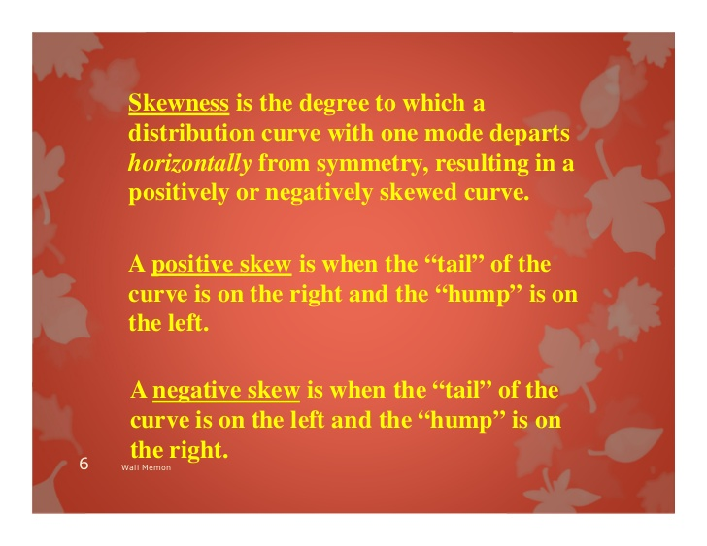

Slide 30
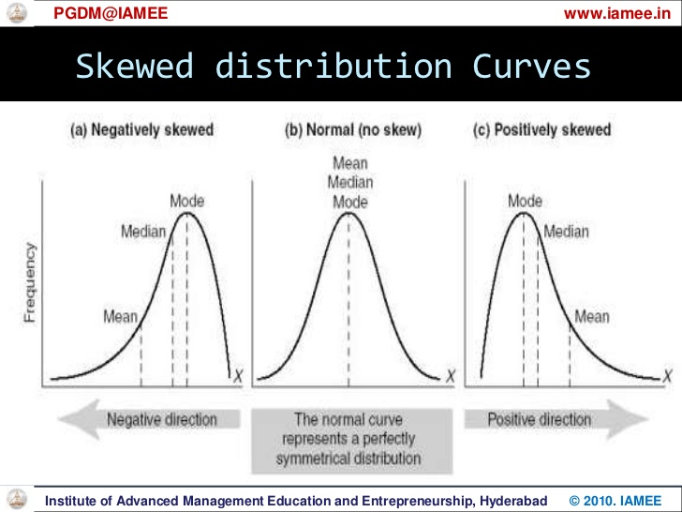

Slide 31


